Slide 1
Create Productive Apps with Office 365
Notes:
DEMOS: https://github.com/Microsoft/InsiderDevTour18-Office

Slide 2
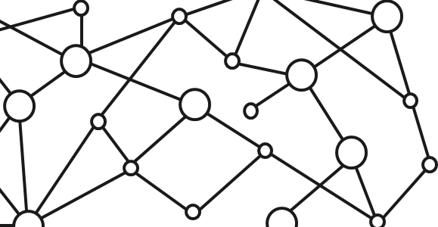
Microsoft 365 Platform
Extend Microsoft 365 experiences
web, device, and service apps
Build your experience
Documents
Pages
Conversations
Timeline
iOS/Android/Windows/Web
1
Microsoft Graph
Notes:
But wait there’s more: You can even extend it, through a wide variety of canvases and experiences – M365 is a platform
M36 includes W10, O35 and enterprise mobility and secuity

Slide 3







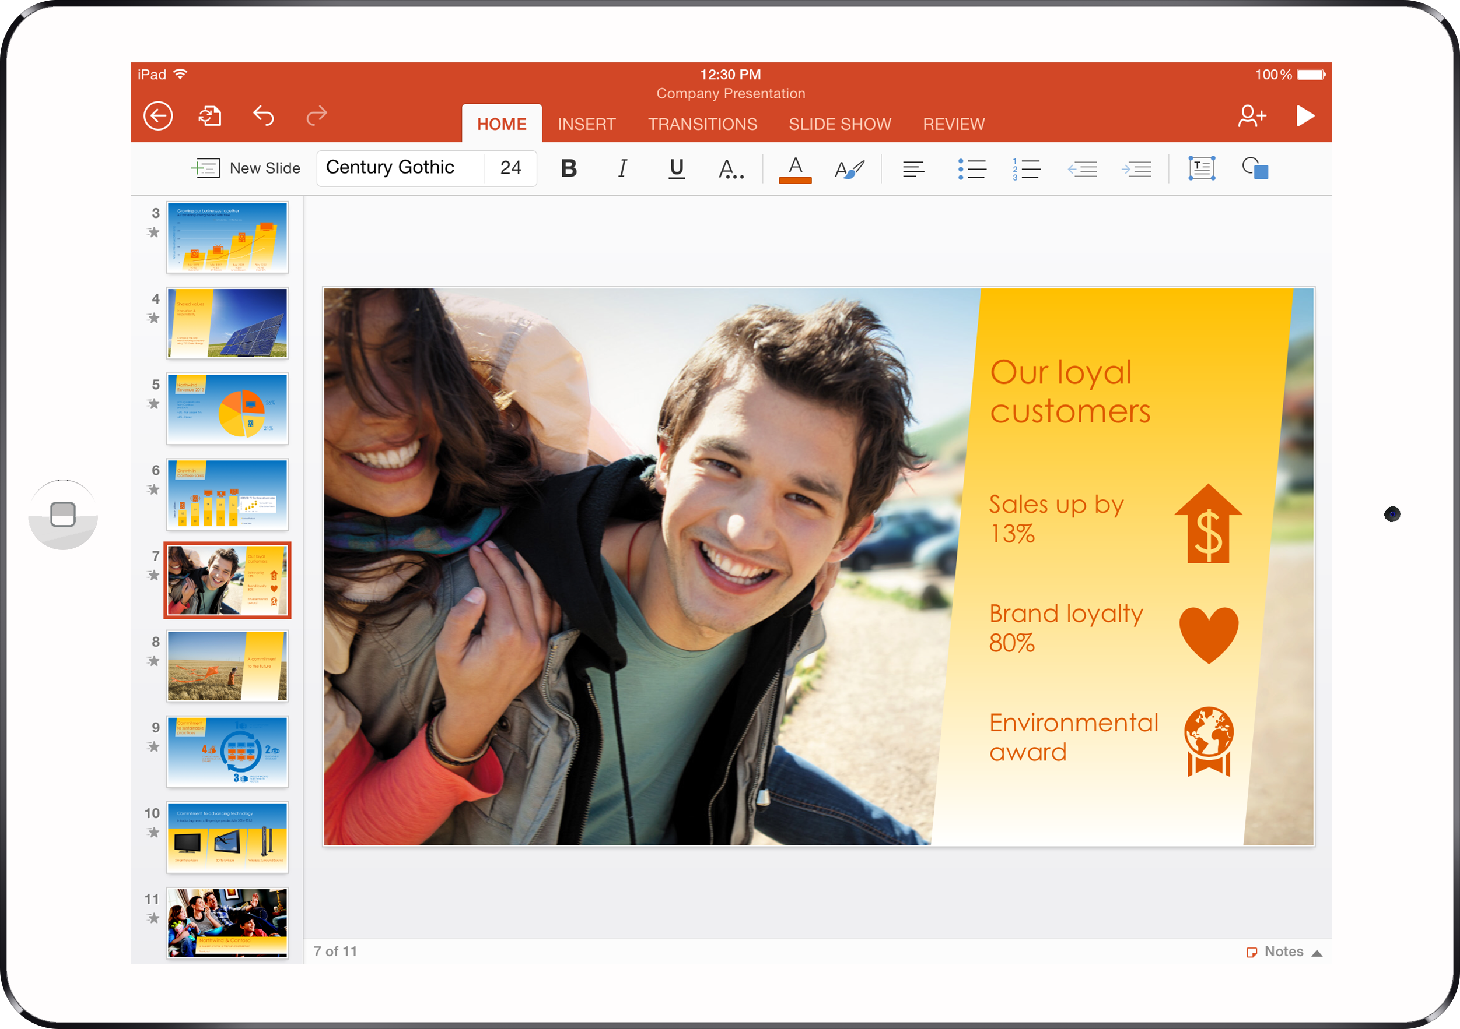

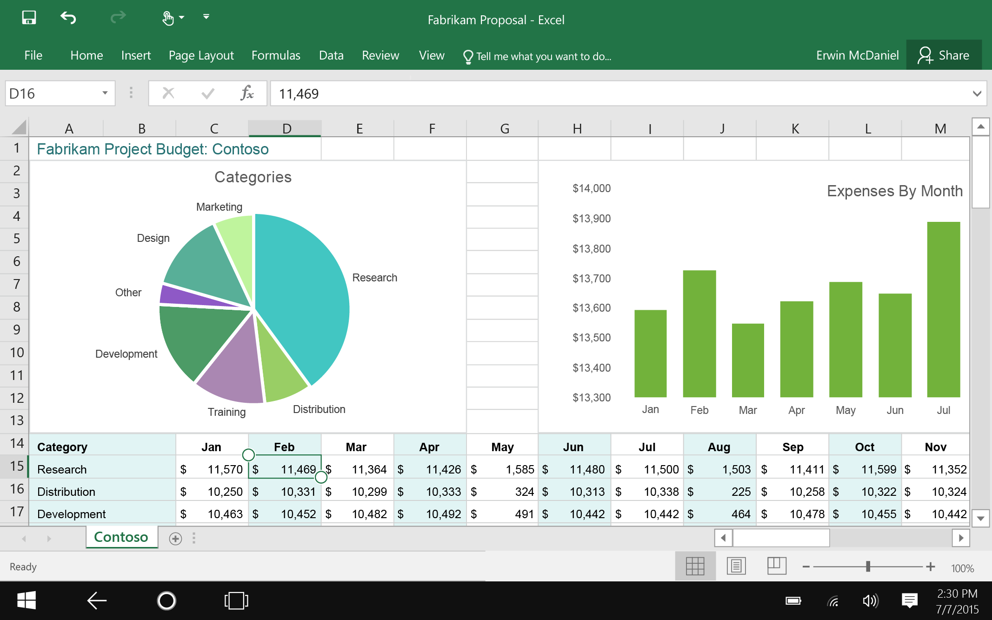
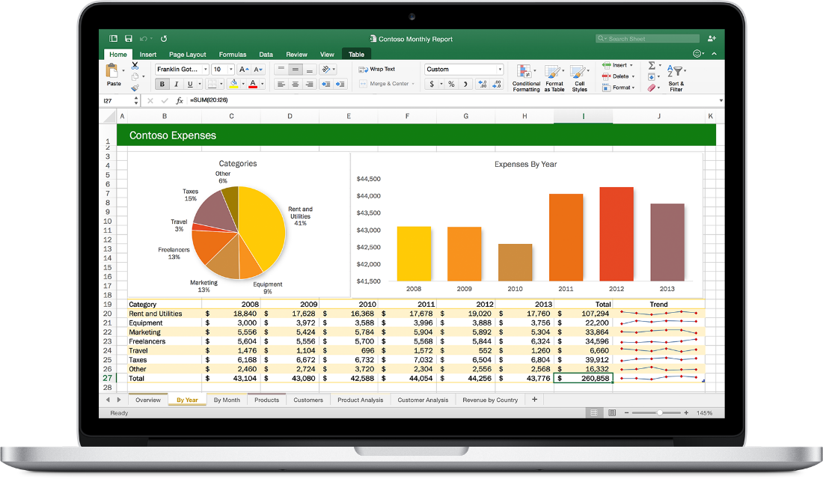


Web technologies
Make your solution part of Office canvases
Cross
platform
Extend Office applications across platforms using web technologies
Modern distribution
Store
Centralized Deployment
Notes:
Through extensions adding new capabilities or new content types make office more tailored and more powerful more useful.
3 big pieces (Web Technologies add-in or SP based on the web)
Web tech allows to support cross platform
Thinking about distribution in the future making sure users can get the asolutions they want/need and get started quickly.

Slide 4
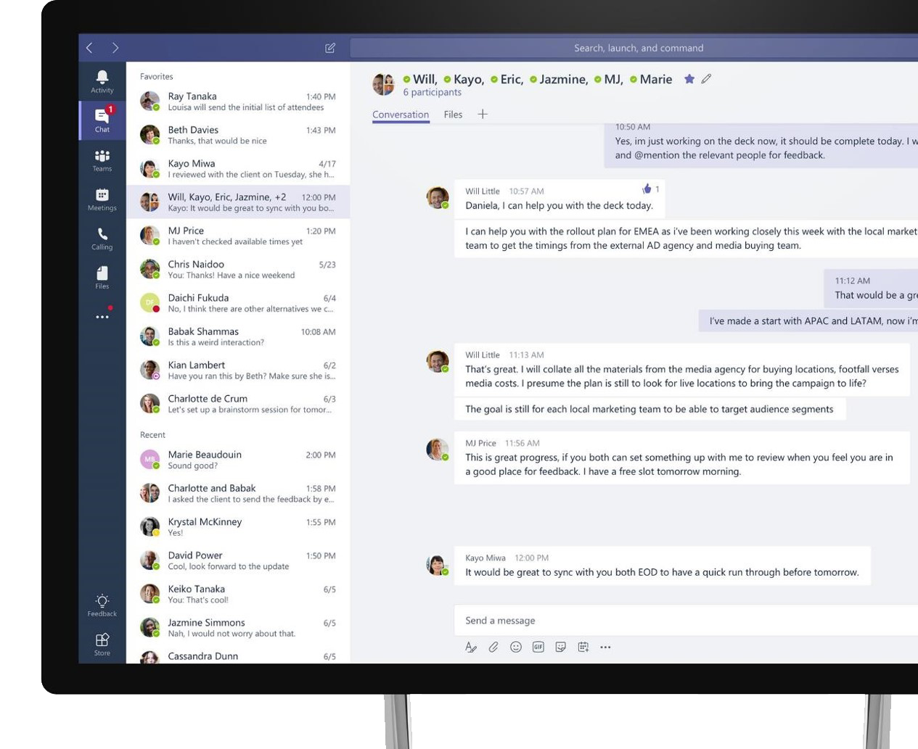
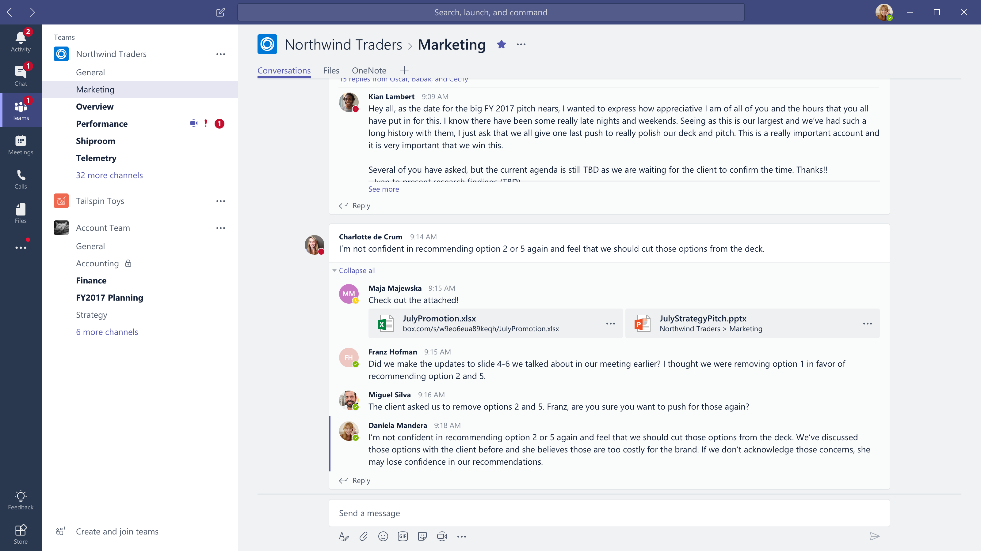


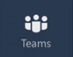
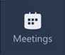


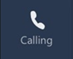



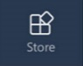
Microsoft Teams
The hub for teamwork in Office 365
Communicate
through chat, meetings & calls
Collaborate
with deeply integrated Office 365 apps
Customize & extend
with 3rd party apps, processes, and devices
Work with confidence
enterprise level security, compliance, and manageability

Slide 5
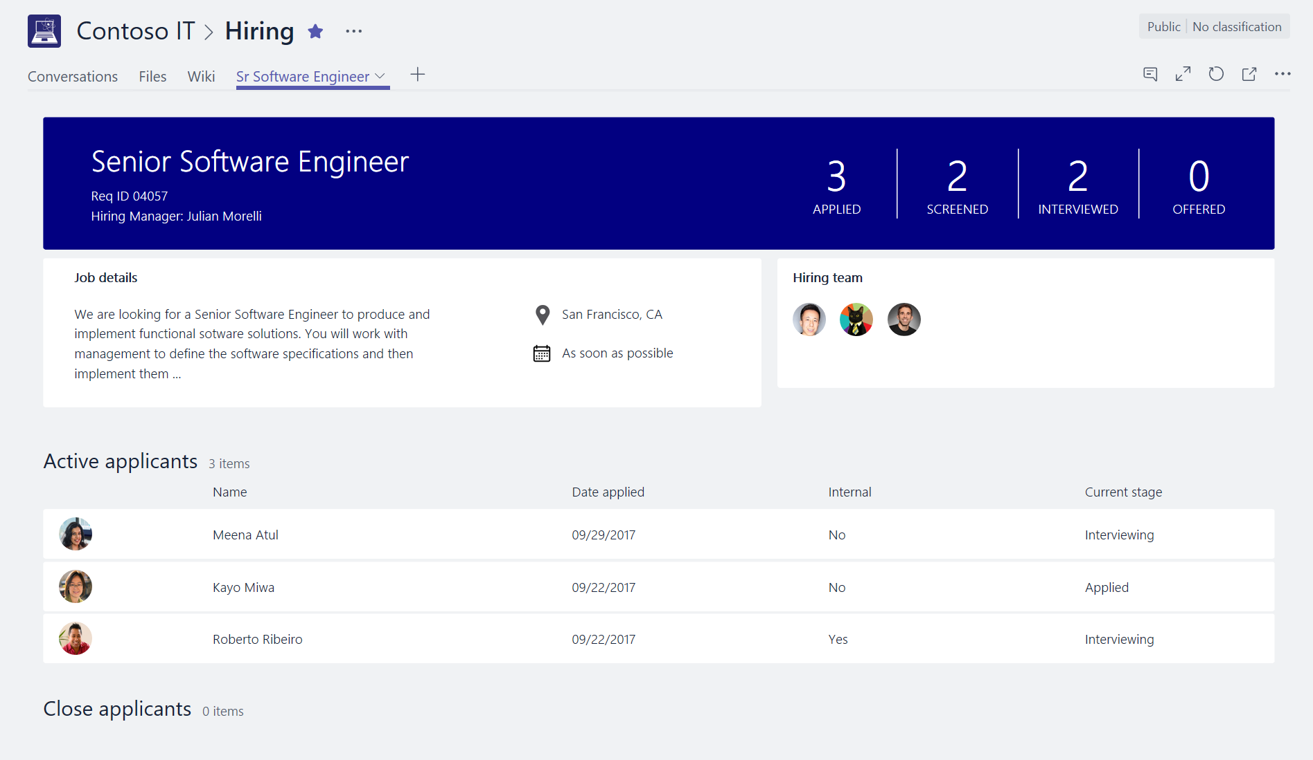
Start with a tab for collaboration
Host your app’s experience directly within Teams
As simple as embedding existing web app content
Integrate and get context via JavaScript SDK
Example: list of applicants to a job position

Slide 6








A quick note on tools…
.net
IIS Express
C#
MSBuild
Project Templates
scripting

Slide 7
Build a Tab
Demo

Slide 8
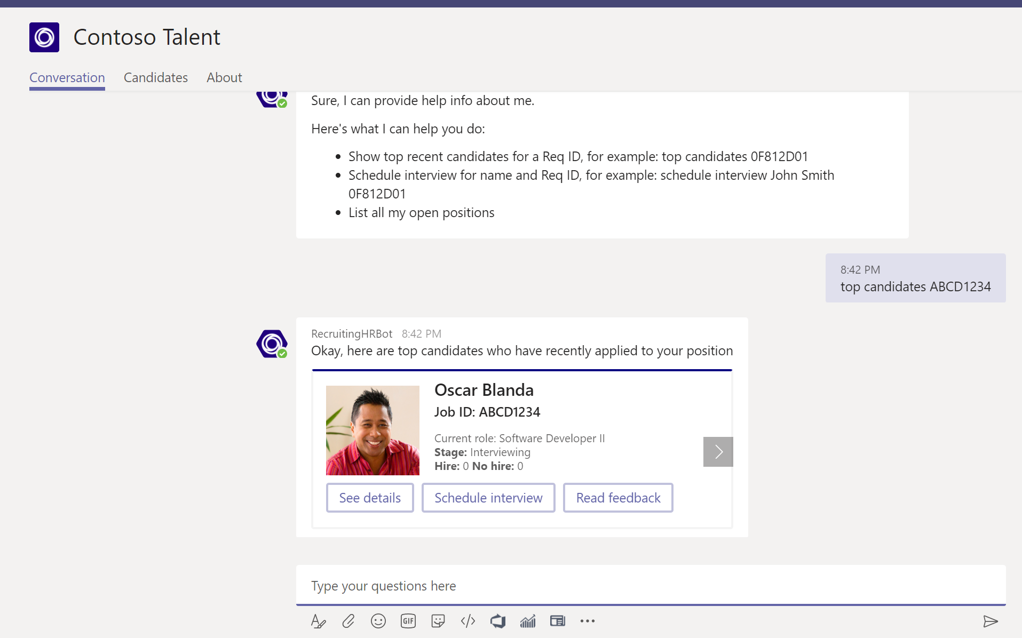
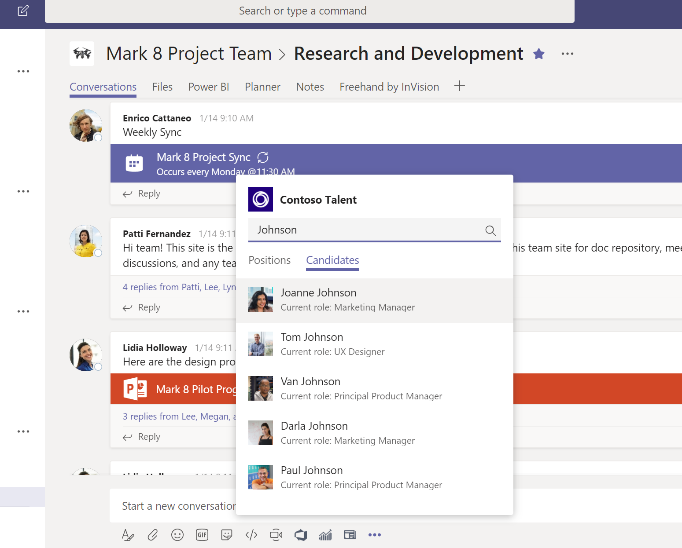
Enhance conversations with bots
Integrate with Azure Bot Services
Natural language interaction through chat bots
Structured commands through messaging extensions
New: send or receive files
New: interact with users in private chats
New: multiple structured commands
New: Bot Builder 4.0 SDK support

Slide 9
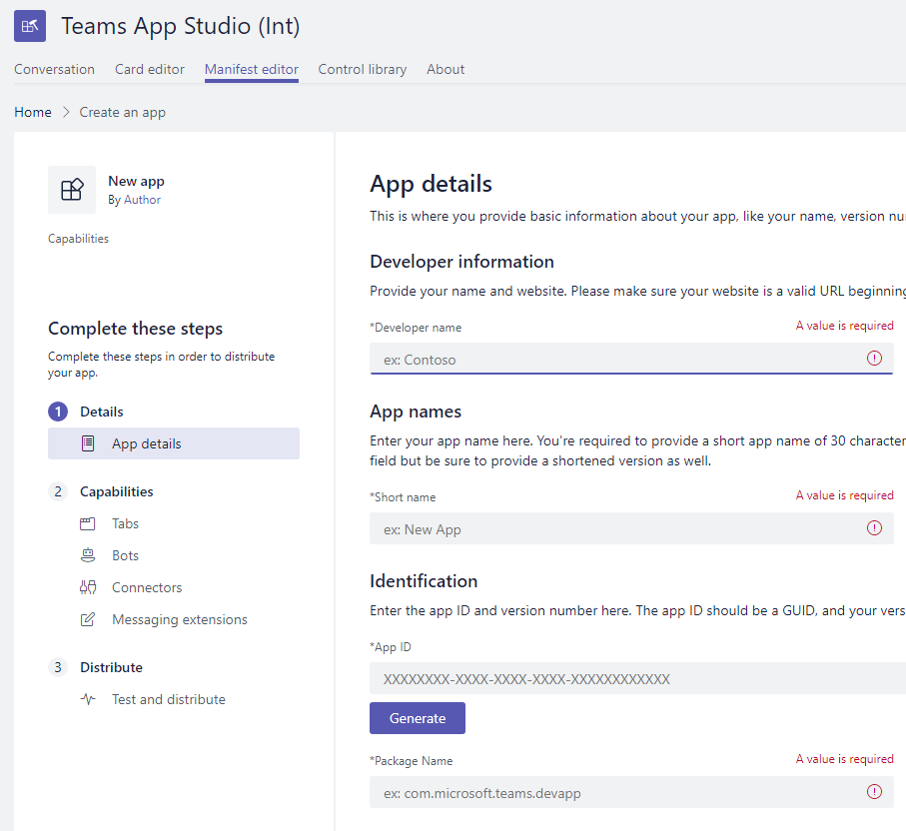
Get up and running using the Teams
App Studio
Tools to help you build your app
Define your app’s manifest through simple forms
Card visualizer and code snippet generator
Web UI control library
New: find documentation topics via chat
New: Teams App Studio saves your app manifest in the cloud
New: in-app registration with Azure Bot Service

Slide 10
Create a Bot
Demo

Slide 11









Manage distribution of Teams Apps
Capabilities
Catalog
My Apps
Admin
App Settings
App Catalog Policies
Consent
+
Install
+ Configure
+ Auth
+ Use
Team Apps
User App Policies
Manifest
Global Apps
Teams Store
(in context)
LOB
Apps
New
New

Slide 12
aka.ms/insiderdevtour-labs
Understand the Office 365 landscape
Build a Teams Tab
Build a Bot
Get started with Microsoft Graph
Notes:
Thank you! To try out some of these new features yourself, please go checkout our HANDS-ON LABS!

